Slide 1
Let the children come to me, and do not hinder them; for to such belongs the kingdom of God
Luke 18:16
Notes:
The Safeguarding Program was developed in response to the Royal Commission into Institutional Child Sexual Abuse.
Initiated in 2014, Perth by Archbishop Timothy Costello
Developed by a team led by Andrea Muslin, an expert in child protection
Launched in Bunbury in September 2018

Slide 2
Aims of the Safeguarding Program:
Prevention of abuse
Minimise risk
Heightening likelihood of detection
Reduce long term impacts of abuse
Notes:
The Safeguarding Program is child focused and informed by a fundamental belief that children have the right to physical and psychological safety at all times. We, the Bunbury Diocese, must play our part in protecting all children and vulnerable individuals.
The aim of the Safeguarding Program is to raise awareness of our collective responsibility to safeguard and promote the welfare of children, young people and vulnerable individuals within the Bunbury Diocese.

Slide 3
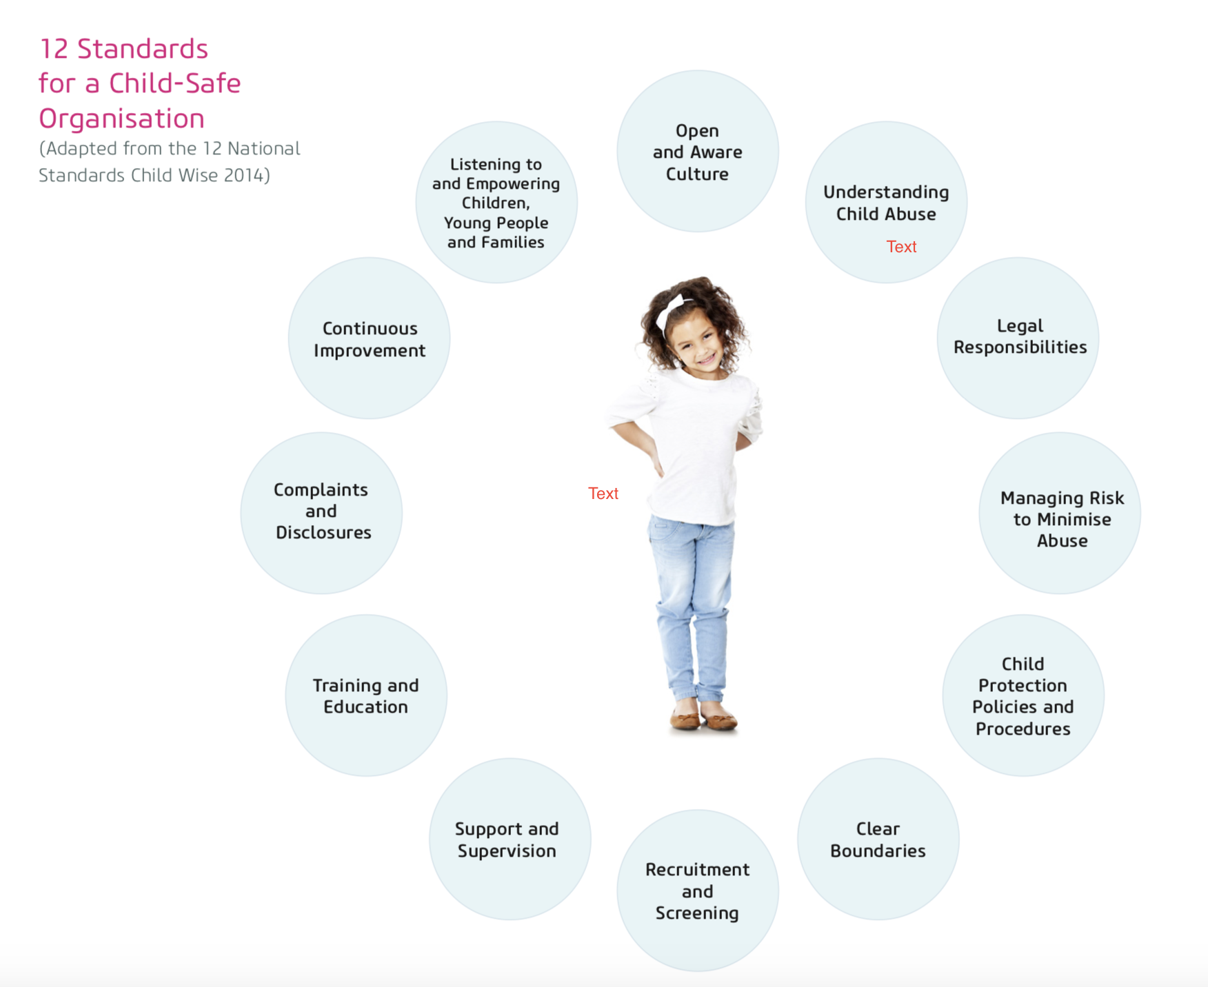
Notes:
Recognising that there is no 100% foolproof system for the complete protection against abuse, the program was and is informed by 12 standards:
Open and aware culture; understanding child abuse; legal responsibilities; managing risk to minimise abuse; child protection policies and procedures; clear boundaries; recruitment and screening; support and supervision; training and education; complaints and disclosures; continuous improvement; listening to and empowering children, young people, and families.

Slide 4
The Routine Activity Theory
Suitable target
Offender
Absence of parent or guardian
Notes:
Simply focusing on identifying offenders is not enough to prevent abuse. Three conditions are required for abuse to occur - an offender, the availability of a vulnerable person and the absence, whether physical or emotional, of a parent or guardian.
For example, an offender cannot abuse a child if said child has appropriate supervision.
The safeguarding program aims to add a layer of supervision to the children and vulnerable of our parishes. The purpose of the program is not only to provide a safe person for someone to talk to, but is a visible sign to potential abusers that we have a transparent and open diocese who put the welfare of our most vulnerable first, and that these vulnerable persons know that there is a safe adult that they can speak to about any potential concerns. This will make our parishes an uncomfortable place for an abuser to exist in.

Slide 5
All children are vulnerable
They are powerless, trust and depend on adults
They are taught to obey adults
Young children cannot assess adults’ motives
Children will tolerate the most painful abuse to maintain emotionally rewarding relationships
Sexual abuse by adults is confusing

Slide 6
Transparency
The transparency created through the Safeguarding Program will benefit every member of our parish.
While some of the requirements may seem burdensome (eg creating registers to track attendance), their purpose is to create open, transparent practice which discourages abusers from targeting our parishes.
Notes:
The registers also serve to protect adults involved with activities that involve children through providing documentation regarding who was with who and where.
We have had feedback from some that they feel uncomfortable when they find themselves alone with other people’s children, the changes being implemented serve to reduce this discomfort as once they are established these uncomfortable situations should become rare.

Slide 7
Safeguarding Officers
The first point of contact for children, vulnerable adults and other members of the parish community regarding suspicions of abuse and other safeguarding concerns
Ensure the parish is complying to the Safeguarding Policy and Procedures
Respond to all safeguarding concerns in line with the diocese’s Safeguarding Policy and Procedures manual, reporting these concerns to the Safeguarding Director and/or other authorities, as needed
Work in partnership with and keep the Parish Priest informed of all concerns, responses and activities relating to safeguarding of the parish community
The link person between the Safeguarding Program Office and the parish for all safeguarding matters
Notes:
Feel free to approach any of us with questions or concerns relating to safeguarding.

Slide 8
Compliance
Working with Children (WWC)*
Complete Form 2 – Personal Declaration
Read the Safeguarding Handbook
Complete Form 18 – Handbook Declaration
*Those who are exempt are required to obtain a National Police Clearance (NPC)
Notes:
WWC – for every adult in child related work. This includes positions that imply authority/power eg Extraordinary Minister of Holy Communion
*Exempt:
Child volunteers,
Students, under 18 year, on unpaid placement
Employers of children and people who work alongside children as fellow employees (unless doing child-related work)
One-off event
Parents volunteering may be exempt,
Short-term visitors to WA (two weeks after arrival, and no more than two weeks in any 12 month period)
Those who are exempt are required to get a National Police Clearance
Everyone is required to complete Form 2

Slide 9
Supervision recommendations
0-2 years 1 adult to 3 children
2-3 years 1 adult to 4 children
4-8 years 1 adult to 6 children
9-12 years 1 adult to 8 children
13-18 years 1 adult to 10 children
The name/s of the adult/s supervising should be displayed/known.
Notes:
**These are not statutory requirements. Activities involving young children, such as the Children’s Liturgy, need more than one adult to ensure supervision requirements are met eg if a child wants to go back to their parents or use the toilet etc. This may require a parent roster to assist the children’s liturgy leader or introducing a minimum age for participation.

Slide 10
Children should be educated regarding who the Safeguarding Officers are their right to approach or contact them whenever necessary
Parent volunteers at one-off events must complete the Form 2 Declaration
There should be a registration system to log each person attending activities involving children
No unsupervised access to internet facilities while engaged in Church-related activities
Photos can only be taken or published with parental consent
Notes:
For every activity involving children…

Slide 11
Safeguarding Officers
Doreen Wijekoon bunburysgo1@gmail.com
Pauline Harling bunburysgo2@gmail.com
Alexis Woolhead bunburysgo3@gmail.com
Ruth Dunne bunburysgo4@gmail.com
Kath Fenton bunburysgo5@gmail.com
https://bunburycatholic.org.au/our-people/safeguarding-office/

Slide 12
Finally…
Notes:
Creating parish standards to adhere to through this program will assist everyone as the burden of transparency is removed from your shoulders.
Questions?

